Slide 1
Removing Clinical Motion Artifacts During Ventilation Monitoring With Electrical Impedance Tomography: Introduction of Methodology and Validation With Simulation and Patient Data
Frontieres in Medicine
Yang et. al., 2022
Notes:
My name is Kyler Howard and today I am reviewing and presenting a paper by Yang et al about removing clinical motion artifacts during electrical impedance tomography.

Slide 2
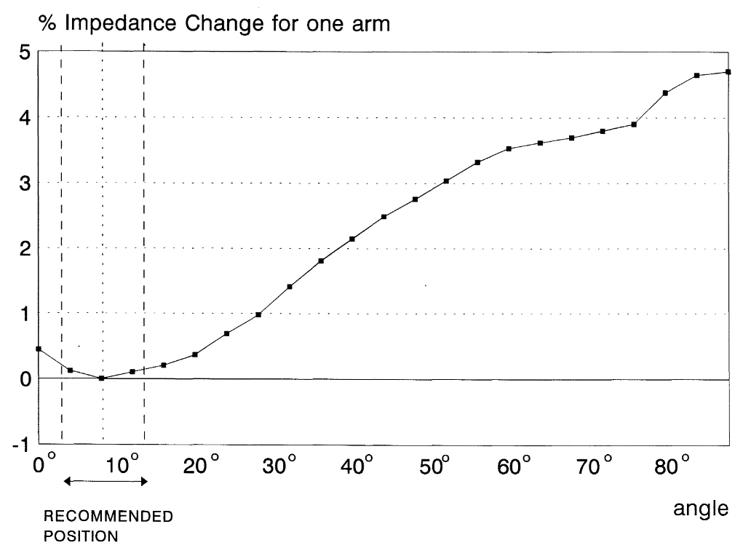
Clinical Artifacts in EIT
Movement of patients changes the impedance value
Lozano et. al
Yang et. al
Notes:
Another important background information for this paper is about clinical artifacts. Clinical artifacts in EIT have to do where movement of the patients changes the impedance value. Lozano et. al in 1995 showed how even abducting the arm from a neutral position can change the contact impedance at electrodes around the torso. The artifacts looked at in this paper are shown in the figure to the right. The first, drifting, is commonly present from repetitive signals such as an air suspension mattress. Step artifacts are caused by movements of a patient into a new position and then them staying there, while spikes occur often when a clinician is in contact with the patient for a short amount of time.

Slide 3
Objective – DWT
Testing the discrete wavelet transform (DWT) to reduce/eliminate artifacts
Detects and removes artifacts for thoracic EIT
Notes:
The objective of this study has to do with something called the discrete wavelet transform. As mentioned, EIT is useful in many cases, but there are no current methods to reduce or eliminate the artifacts produced. The researches wanted to test using the discrete wavelet transform to automatically detect and remove these artifacts.
The wavelet transform can be thought of in a similar way to the Fourier transform. Instead of a basis of continuous sign waves though, an individual wavelet shown in blue/red/green in the figure is slid across your signal. Each wavelet chosen has a unique scale, and then the wavelets and signals are convoluted together to determine how much of that wavelet occurs in that specific location. This is repeated to form a basis of wavelets that make up your signal. The wavelet transform is unique in that it can detect local spectral and temporal information simultaneously and there are many wavelets to choose from.

Slide 4
DWT Scheme
Notes:
Here is the specific wavelet scheme that Yang et al created. They would decompose their signals into slow-varying (a) signals and fast-varying (d) signals. They were able to identify which of these base signals corresponded with each artifact, and then could eliminate these signals in the reconstruction. This is very similar to how you would remove a constant frequency noise from any signal, but the discrete wavelet transform can isolate noises that only occur locally instead of globally.

Slide 5
Simulated Signals
Simulated respiratory signal with Gaussian noise
Notes:
To start, the researchers created a simulated noisy signal with both respiratory and cardiac contributions in MATLAB. Then they applied this signal to their three artifacts then creating three test cases.

Slide 6
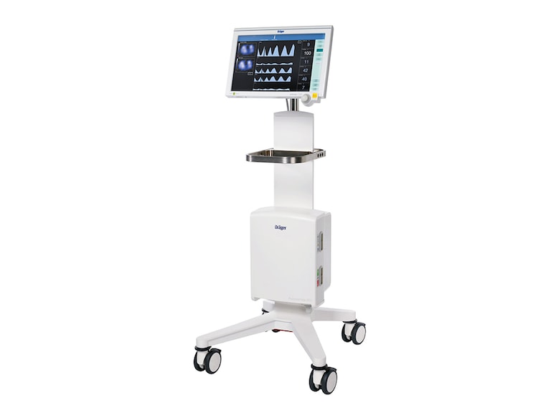
Data Collection
Dräger PulmoVista® 500
Single belt of 16 electrodes
Current on 2 electrodes
2 subjects
Notes:
In addition to simulated data, Yang et al also collected real patient data in China. They used the Drager PulmoVista 500, which is the current top commercially available EIT system. It uses a single belt of 16 electrodes and applies current to two electrodes at a time while measuring voltage on all the electrodes. They took data on only two patients, which will be discussed later.

Slide 7
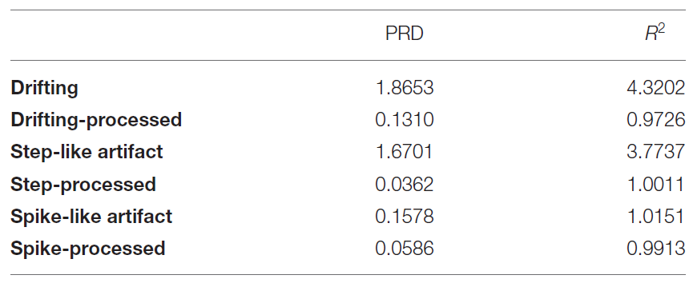
Simulated Validation
Simulated respiratory signal with Gaussian noise
Notes:
The first results were on the simulated signals. For all three, you can clearly see that the red processed lines removed the artifacts from the darker signals while maintaining the original shape of the curves. This is numerically shown in both the percent root difference and the r squared value below. For all three processed signals, the percent root differences are very close to 0 and the r squared values are all near to 1, which is a great sign. The percent root differences improved by around 95% for the drift and step, and around 60% for the spike.
PRD: consistency
R2: similarity

Slide 8
Clinical Drift Artifact
Patient 1
Moderate ARDS
Mechanically ventilated
Notes:
The analysis of the drift artifact was done on patient 1 who had moderate acute respiratory distress syndrome and was mechanically ventilated. You can clearly see the processed signal looks much nicer, but it also cleaned up the images produced. With this improved signal, now it is clear that the patient is only receiving ventilation on the ventral side where earlier one might have assumed that there was slight ventilation on the dorsal side as well.

Slide 9
Clinical Step Artifact
Patient 1
Moderate ARDS
Mechanically ventilated
Notes:
Up next was the step artifact, again on patient 1 with ARDS. Here you can really tell that the processed signal kept the same shape for each sawtooth during the stepped-up region, but they did not report what their processed signal looked like during the gray step bar. I would’ve personally loved to see the red signal having continued throughout that. Either way, the resulting images after processing do look much more like what one would expect for this case.

Slide 10
Clinical Spike Artifact
Patient 2
Moderate COPD
Pulmonary rehabilitation
Notes:
Finally, the spike artifact was observed in patient 2 who had moderate chronic obstructive pulmonary disease and was undergoing pulmonary rehabilitation. They had a much messier signal which I do not think was the best to show for how this algorithm worked, but the resulting images still came out as one would expect. A lot of EIT is not about having the most perfect images, but instead showing the general trends. With that in mind, I’d still say that this test was successful for the spike artifact.

Slide 11
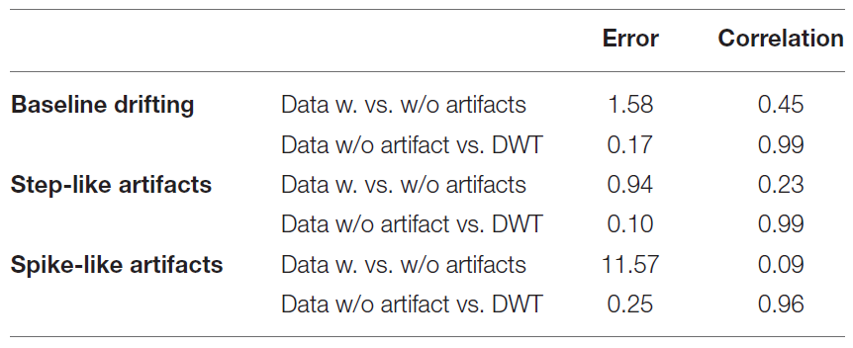
Clinical Summary
Image correlations >0.95
Notes:
To quantify the results of all three clinical tests, they looked at the pixel-based errors and correlations. The image errors all dropped by about 90 to 95 percent when using the wavelet transform, and the image correlations between EIT images without artifacts and the processed ones were all above 0.95 which is great. Overall, this is very promising for this method to remove artifacts.

Slide 12
DWT Comments
From Authors
Localization property of DWT is helpful
One filter for three artifacts
Additional comments
Are these filters the same for varying subjects?
Did not provide exact parameters for wavelets corresponding to artifacts
Notes:
Both the author and I have some comments on the discrete wavelet transform used as well as some limitations in the next slide.
They pointed out that the localization property of wavelets is extremely helpful for eliminating these local sources of noise. Additionally, with this transform they can create one filter that eliminates all three artifacts simultaneously instead of having to make three different filters or use varying methods.
I am curious though if this filter would be the same for all subjects, or would they have to identify the specific wavelets required for an individual subject. That would take much more time and could potentially stop this from being a real-time clinical method. Additionally, they did not provide the exact scale parameters for the wavelets they used, so it would be hard to replicate this quickly and check.

Slide 13
Limitations
From Authors
Real-time processing
Multi-artifact processing
Other artifact sources
Additional limitations
Number of subjects
More spike testing
Notes:
In terms of limitations, the authors acknowledged that they did not even try to pursue real-time processing in this study, but mentioned it is their next priority which is encouraging. They also want to try applying the 3 in one filter on a subject/data that has multiple artifacts at the same time, instead of the single artifact processing they demonstrated here. Lastly, they mentioned how there are probably more sources of artifacts that could be detected with other wavelets, and they would like to expand their filter to include them eventually.
As mentioned in the previous slide, I am curious about the ease of application to multiple subjects, so I would have appreciated if they had a large dataset for this study to show how the same wavelet scheme can be applied to multiple people. I also would have liked more spike testing or at least a cleaner section of data with a spike in it to really see how the processed signal stayed the same instead of what we were shown.

